Slide 1

Examining the Role of a Fourth Treatment Modality: Tumor Treating Fields (TTFields)
Notes:
1

Slide 2
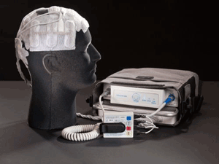
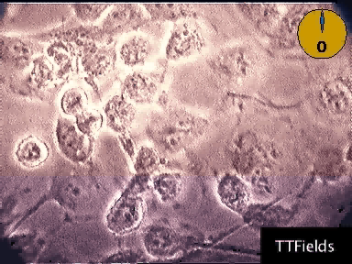
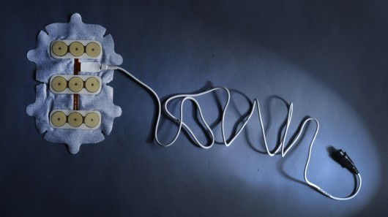
TTFields: From Bench to Bedside
Stupp R, et al. Eur J Cancer. 2012;48(14):2192-2202. Fonkem E, et al. Exp Rev Neurother. 2012;12(8):895-899.
Notes:
There is a “novel” factor to the TTF treatment, but it comes with a “fear” factor so very important to explain to our patients how this therapy works.
History - Began about 14 years ago, with a lot of pre-clinical work by a small group of researchers
Alternating electric fields that do not radiate or shock the person’s brain but work in a frequency specific to glioblastomas
System includes the arrays for the head with cords attached to plug into a battery pack

Slide 3
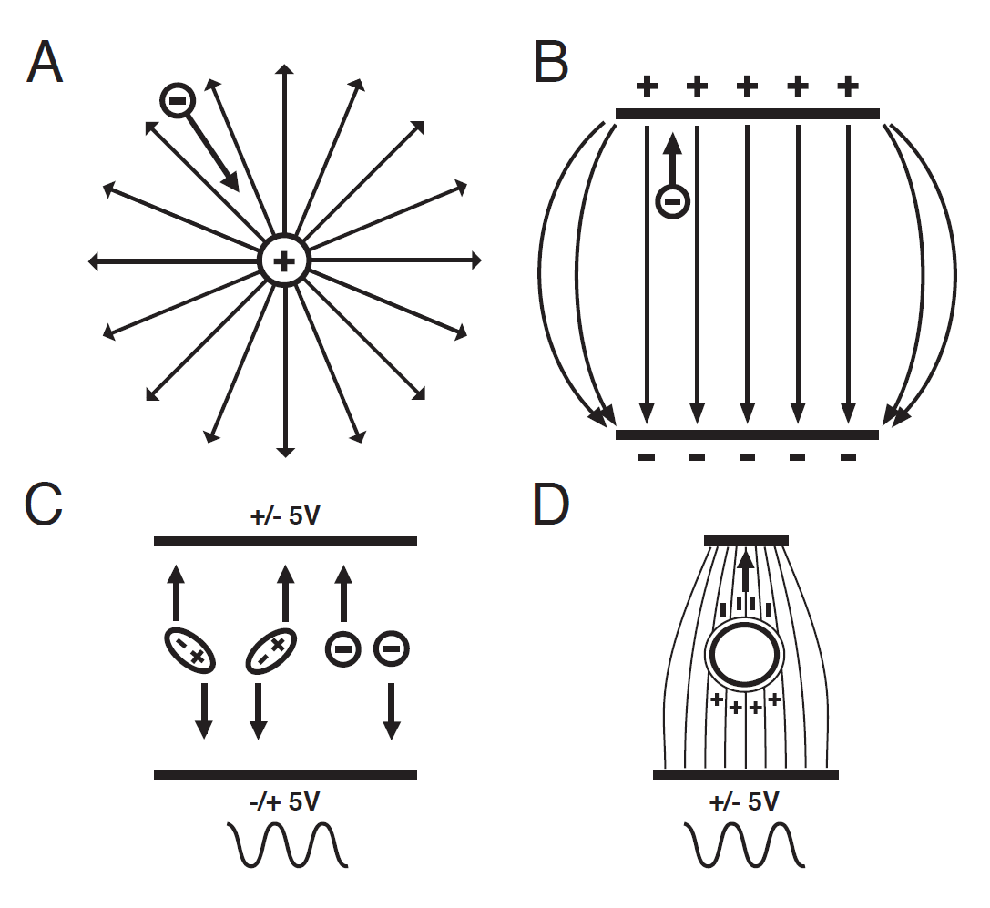
Electric Field Effect on Charges and Dipoles
An electric field is a potential difference in space
Charges move and dipoles oscillate in a uniform alternating electric field
Gutin P, et al. Presented at: 2012 ASCO Annual Meeting Education Session; June 1-5, 2012; Chicago, Illinois. Available at: http://meetinglibrary.asco.org/content/66664. Accessed September 16, 2013.
Notes:
Basic science – this treatment is based on charges moving back and forth in a uniform alternating electric fields
Assume there are 2 plates in space and you have even distribution between the 2
You can you can adjust this field and change the intensity depending and change treatment depending on where the plates are placed
3

Slide 4
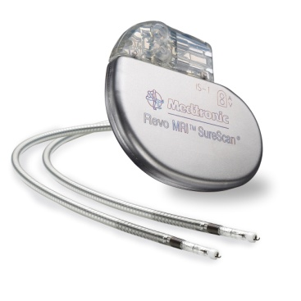
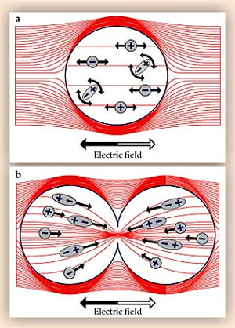
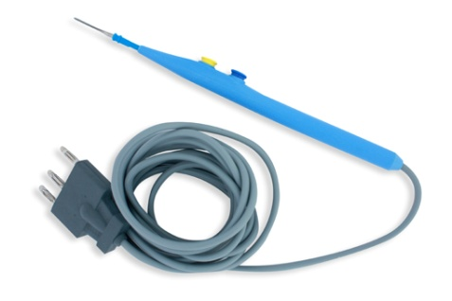
Use of Electric Fields in Medical Devices
Cardiac pacemaker; <1KHz
LOW
Tumor treating fields; 100-300kHz
MEDIUM
Diathermy; > 1 MHz
HIGH
Notes:
This slides shows the difference in electric fields of a variety of medical devices from low to high
Pacemaker being the lowest at 1kHz and electric cautery or bovie being the highest with TTF in the middle (ranging from 100-300kHz customized to tumor type)

Slide 5
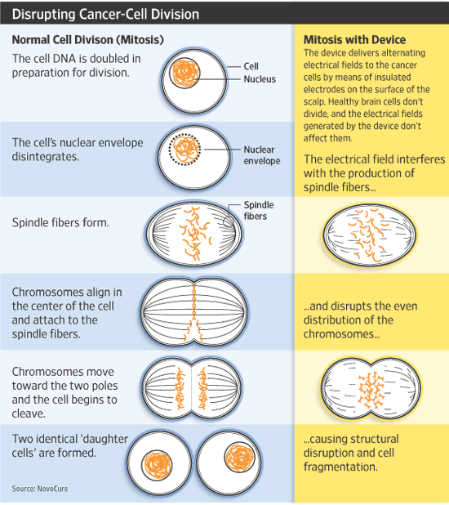
Notes:
Key to TTF is the disruption of cancer cell division
Example of normal cell division on the left and what happens to mitosis with the device in place on the right – a structural disruption and cell fragmentation

Slide 6
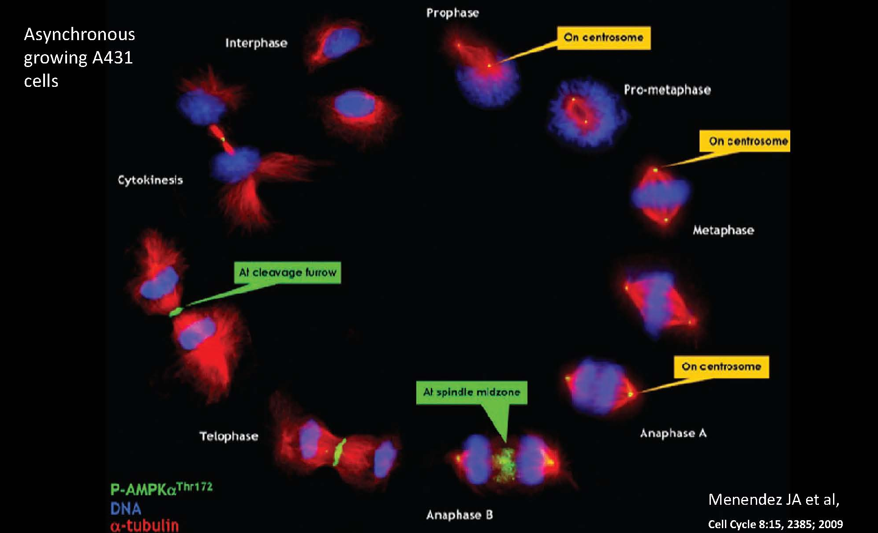
Tumor Treating Fields Appear to Affect Cells After
DNA Damaging Agents and Spindle Poisons
DNA damaging
agents
G2/M checkpoint
Paclitaxel
SAC checkpoint
NovoTTField
Menendez JA, et al. Cell Cycle. 2009;8(15):2385-2398.
Notes:
DNA breaking agents act during prophase.
paclitaxel acts during pro-metaphase and metaphase
TTF acts during metaphase, anaphase and the most recent research shows during telophase so we are targeting the cell cycle during 3 different phases
Off label – you could add chemo therapy during TTF treatment

Slide 7


Slide 8
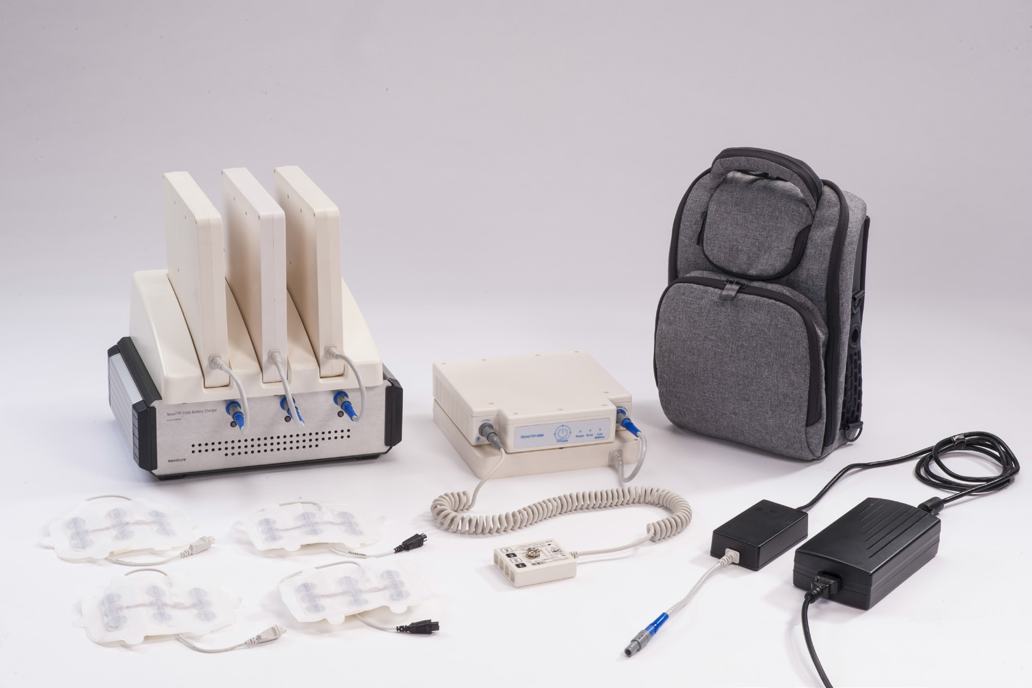

Slide 9
EF-11: Phase III Study in Recurrent Glioblastoma
NovoTTF-100A System
n = 120
Surgery/biopsy
RT/TMZ + maintenance TMZ
Recurrence
N = 237
Randomized 1:1
Physician’s choice
chemotherapy
n = 117
28 institutions in 7 countries
Stratification
Treatment center
Surgery prior to trial entry
Other inclusion criteria
Radiologically confirmed disease progression
Karnofsky performance status ≥70%
Primary endpoint: Overall survival
Secondary endpoints: PFS, 6-month PFS, 1-year survival, radiologic response, quality of life (QoL)
Stupp R, et al. Eur J Cancer. 2012;48(14):2192-2202.
Notes:
Key inclusion criteria
Patients 18 years of age or older with histologically confirmed GBM
Radiologically confirmed disease progression
Karnofsky performance status ≥ 70%
Prior therapy must have included radiotherapy (with or without concomitant and/or adjuvant temozolomide)
Key exclusion criteria
Infra-tentorial tumour location
Patients with implanted electronic medical devices
Primary endpoint of Overall survival
2nd endpoint of progression free survival (PFS), 6 month PFS, 1-year survival, radiologic response, and quality of life
9
Stupp 2012: p2195

Slide 10
EF-11: Patient Characteristics
 | NovoTTF-100A System (n = 120) | Active control (n = 117)
Age (year), median (range) | 54 (24-80) | 54 (29-74)
Gender, (male), n (%) | 92 (77) | 73 (62)
Histology
Glioblastoma, % | 100 | 100
Prior lower grade glioma, n (%) | 10 (8) | 9 (8)
Karnofsky performance status, median (range) | 80% (50-100) | 80% (50-100)
Steroid use at enrollment
Yes, n (%) | 55 (46) | 62 (53)
No, n (%) | 55 (46) | 49 (42)
Unknown, n (%) | 10 (8) | 6 (5)
Largest tumor diameter at randomization (cm), median (range) | 6.1 (0-15.2) | 5.5 (0-16.2)
Interval from initial glioma diagnosis (month), median (range) | 11.8 (3.2-99.3) | 11.4 (2.9-77.1)
Stupp R, et al. Eur J Cancer. 2012;48(14):2192-2202.
Notes:
Patient characteristics
237 patients between 2 arms (randomized 1:1)
even distribution but with a majority of patients being male
Karnofsky Performance Status median range was 80%
steroid use at enrollment was 50%
average length of time since diagnosis was 11.8 months for TTF and 11.4 months for the active control
10
Stupp 2012: p2197/Table1

Slide 11
EF-11: Prior Treatments in Subjects
 | NovoTTF-100A system (n = 120) | Active control (n = 117)
1st recurrence, n (%) | 11 (9) | 17 (15)
2nd recurrence, n (%) | 58 (48) | 54 (46)
3rd or greater recurrence, n (%) | 51 (43) | 46 (39)
Surgery
Debulking before enrollment, n (%) | 33 (28) | 29 (25)
Debulking at any stage, n (%) | 95 (79) | 99 (85)
Biopsy only, n (%) | 25 (21) | 18 (15)
Radiotherapy, % | 100 | 100
With concomitant temozolomide, n (%) | 103 (86) | 96 (82)
No concomitant temozolomide, n (%) | 15 (13) | 20 (17)
Unknown, n (%) | 2 (1) | 1 (1)
Prior adjuvant (maintenance) temozolomide, n (%) | 100 (83) | 89 (76)
Median number of cycles (range) | 4 (0–19) | 3 (0–27)
Prior bevacizumab, n (%) | 23 (19) | 21 (18)
Stupp R, et al. Eur J Cancer. 2012;48(14):2192-2202.
Notes:
Prior treatments
primary recurrence was small number in each arm
2nd recurrence 58 for TTF and 54 in the control
3rd recurrence or greater was 51 for TTF and 46 in the control
- these are the patients we struggle with the most on what to offer
Surgery before enrollment numbers were equally distributed
Radiotherapy with temozolomide 103 patients in the TTF arm and 96 in the control
Radiotherapy without temozolomide 15 patients in the TTF arm and 20 in the control
Prior maintenance temozolomide 100 patients in the TTF arm and 89 in the control
Prior use of bevacizumab – 23 patients in the TTF arm and 21 in the control
11
Stupp 2012: p2197/Table1

Slide 12
EF-11: Active Control Chemotherapy Regimens
Therapy | Number of patients (%)*
Bevacizumab | 36 (31)
Irinotecan | 36 (31)
BCNU/CCNU | 29 (25)
Carboplatin | 15 (13)
Temozolomide | 13 (11)
PCV | 10 (9)
Other | 7 (7)
None | 4 (3)
*Multiple listings possible; some agents given in combination
BCNU/CCNU, lomustine/carmustine; PCV, procarbazine + lomustine + vincristine chemotherapy regimen
Stupp R, et al. Eur J Cancer. 2012;48(14):2192-2202.
Notes:
Control arm patients who were receiving systemic therapy will not add up to 100% because some were on doublet or triplet therapy:
36 bevacizumab
36 irinotecan
29 BCNU/CCNU combination therapy
15 carboplatin
13 temozolomide
10 PCV combination
7 other
None: (4) withdrew consent from chemo arm as they wanted to be randomized to device arm
12

Slide 13
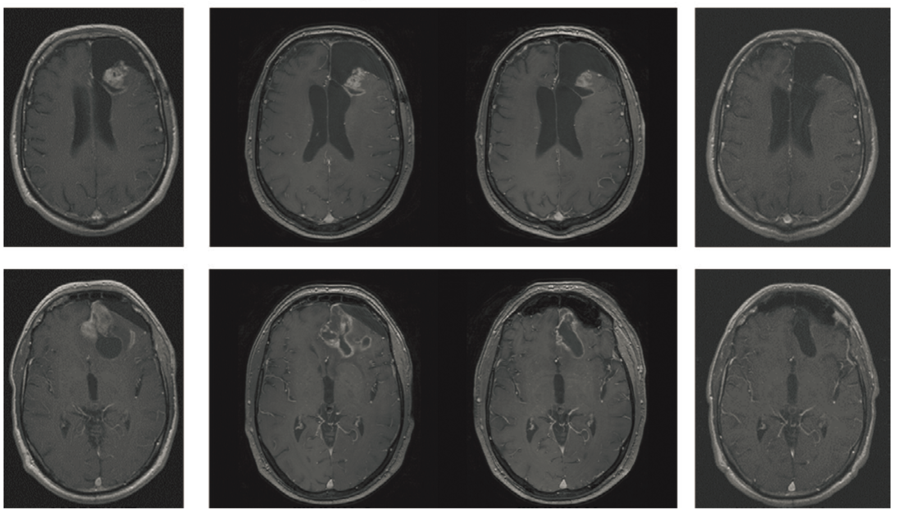
Delayed Response or Pseudoprogression
While on NovoTTF-100A Therapy
MRI of a complete responder treated with NovoTTF-100A Therapy
Transient progression or pseudoprogression occurred at 2 months after starting NovoTTF-100A Therapy
Partial response was noted only after 6 months and complete response was noted after 12 months
Wong ET, et al. Neuro Oncol. 2012;14:vi65-vi85 (suppl 6; abstr NO-47).
Notes:
Example of what we see as we treat more of these patients – a delay in response
If you follow the images you may see a progression occurred at 2 months but the patient is actually stable
Sometimes you just have to stay with the therapy to see the actual partial response after 6 months – more information will be coming out about this
What this is showing – this therapy works in dividing cells and not all cells divide at the same time so you may have a delayed response

Slide 14
EF-11: Progression-Free Survival in the ITT Population
1.0
Fraction Survival
0.9
 | NovoTTF-100A treatment (n = 120) |  | Chemotherapy (n = 117)
Median PFS, months | 2.2 |  | 2.1
Log-rank P value | 0.16
HR (95% CI) | 0.81 (0.60–1.09)
PFS 6-month (95% CI) | 21.4% (13.5–29.3) | 15.1% (7.8–22.3)
P value | 0.13
0.8
0.7
0.6
NovoTTF-100A System
0.5
0.4
Chemotherapy
0.3
0.2
0.1
0.0
0 26 52 78 104 130 156
PFS, weeks
At risk | 0 w | 13 w | 26 w | 39 w | 52 w | 65 w | 78 w | 91 w
NovoTTF-100A | 120 | 38 | 19 | 14 | 11 | 6 | 4 | 3
BPC | 117 | 34 | 14 | 10 | 3 | 1 | 0 | 0
Objective radiological responses
NovoTTF-100A Treatment group (n = 14)
Chemotherapy group (n = 7)
BPC, physician's choice chemotherapy
Stupp R, et al. Eur J Cancer. 2012;48(14):2192-2202.
Notes:
EF-11 PFS in the ITT population
Yellow line is the patients treated with monotherapy with TTF and the green line is the systemic therapy
The median PFS for TTF was 2.2 months and 2.1 months for the chemo arm
This was not statistically significant but even PFS of about 2 months or comparable
Reminder this is a very refractory group of patients where not much works
14
Stupp 2012: p2197/Fig2B

Slide 15
EF-11: Overall Survival in the ITT Population
1.0
NovoTTF-100A Treatment
Fraction Overall Survival
 | NovoTTF-100A treatment (n = 120) | Chemotherapy (n = 117)
Median OS, months | 6.6 | 6.0
Log-rank P value | 0.27
HR (95% CI) | 0.86 (0.66 – 1.12)
1-year survival | 20% |  | 20%
0.9
0.8
Chemotherapy
0.7
0.6
0.5
0.4
0.3
0.2
0.1
0.0
0 6 12 18 24 30 36 42 48
Overall Survival, months
At risk | 0 m | 6 m | 12 m | 18 m | 24 m | 30 m | 36 m | 42 m | 48 m
NovoTTF-100A | 120 | 63 | 24 | 15 | 9 | 7 | 4 | 2 | 1
BPC | 117 | 56 | 22 | 14 | 6 | 2 | 1 | 0 | 0
Stupp R, et al. Eur J Cancer. 2012;48(14):2192-2202.
Notes:
EF-11 : OS in the ITT population
median OS in TTF was 6.6 months and 6.0 months in the chemotherapy arm
Take home point – interpret this as comparable therapy and thus the reason for the FDA approval
15
Stupp 2012: p2197/Fig2A

Slide 16
EF-11: Overall Survival in Responders vs Nonresponders
NovoTTF-100A System
Chemotherapy
100
Responders
(median OS 24.8 months)
100
Responders
(median OS 20.0 months)
80
Nonresponders
(median OS 6.2 months)
80
Nonresponders
(median OS 6.8 months)
60
60
Survival (%)
Survival (%)
40
40
20
20
0
0
0
10
20
30
40
50
60
0
10
20
30
40
50
60
Months
Months
14 of 120 (11.7%) patients exhibited a radiological response while on NovoTTF-100A therapy, median time to response of 8.4 months (95% CI, 6.9-9.9 months)
7 of 117 (6.0%) patients exhibited a radiological response while receiving BPC chemotherapy, median time to response of 5.8 months (95% CI, 3.6-8.0 months)
Three complete responses were seen on trial
All three were from patients in the NovoTTF-100A system cohort
Wong ET, et al. Neuro Oncol. 2012;14:vi65-vi85 (suppl 6; abstr NO-47).
Notes:
Patients showing a radiological response to NovoTTF therapy had favorable baseline characteristics and were highly compliant with treatment
Median age of 54, median KPS of 90%
Baseline tumor area 13 cm²
36% had prior low-grade gliomas
Median duration of device usage was 22 hours/day (range 13-23 hours/day)
Hypothesis generating for those patients who have responded to TTF therapy and continue to respond today
16

Slide 17
EF-11: Correlation Between Overall Survival and Treatment Compliance
Subgroup analysis of patients receiving NovoTTF-100A therapy
12
10
8
6
4
2
0
7.7
P = .04
Overall Survival, months
4.5
≥18 hours
<18 hours
Hours per Day on Therapy
78% of patients completed 4 weeks of therapy (1 cycle)
>80% of patients were compliant 75% of the time
Median compliance was 86% (range 41%-98%) translating to a mean use of 20.6 hours per day
Notes:
Important SLIDE – showing that wearing the device makes a difference!
EF-11 Correlation between OS and treatment compliance
A subgroup analysis of EF-11 data was performed to see if a correlation existed between treatment compliance and overall survival.
Higher overall survival was observed in patients who were treated with the Novo-TTF 100A system for 18 hours or more every day.
The median OS was 7.7 months versus 4.5 months, in patients treated 18 hours or more every day versus those treated less than 18 hours every day
Patients should strive to increase their time on therapy and maintain at least 18 hours per day or 75% of the time.
17

Slide 18
EF-11: Treatment-Emergent Adverse Events ≥Grade 2
 | NovoTTF-100A treatment (n = 116) |  | Chemotherapy (n = 91)
 | ≥Grade 2 (%) | Grade 3/4 (%) | ≥Grade 2 (%) | Grade 3/4 (%)
Hematological | 3 | 0 | 17 | 4
Leukopenia | 0 | 0 | 5 | 1
Neutropenia | 0 | 0 | 2 | 1
Thrombocytopenia | 1 | 1* | 7 | 2
Gastrointestinal disorders | 4 | 1 | 17 | 3
Abdominal pain | 0 | 0 | 3 | 0
Diarrhea | 0 | 0 | 6 | 2
Nausea | 2 | 0 | 7 | 0
General deterioration and malaise | 5 | 1 | 6 | 1
Infections | 4 | 0 | 8 | 1
Skin rash (transducer arrays) | 2 | 0 | 0 | 0
Metabolism and nutrition disorders | 4 | 1 | 6 | 3
Renal and urinary disorders | 3 | 1 | 3 | 0
*Thrombocytopenia from prior chemotherapy; normalized subsequently
Stupp R, et al. Eur J Cancer. 2012;48(14):2192-2202.
Notes:
EF-11 Treatment emergent AEs
The typical systemic side-effects of chemotherapies were not observed in the TTF treated patients
Significantly more gastrointestinal, hematological, and infectious adverse events were seen in the chemotherapy group than the TTF group
Mild to moderate (grade 1 and 2) contact dermatitis on the scalp beneath the transducer arrays occurred in 16% of TTF patients.
Contact dermatitis was easily treated with topical corticosteroids, resolved completely after treatment was stopped and did not require substantial treatment
NovoTTF-100A Speaker Program
11/25/2014
18
Stupp 2012: p2199/Table2

Slide 19
EF-11: Treatment-Emergent Adverse Events ≥ Grade 2
 | NovoTTF-100A treatment (n = 116) |  | Chemotherapy (n = 91)
 | ≥Grade 2 (%) | Grade 3/4 (%) | ≥Grade 2 (%) | Grade 3/4 (%)
Nervous system disorders | 30 | 7 | 28 | 7
Brain edema | 0 | 0 | 2 | 0
Cognitive disorder | 2 | 1 | 2 | 1
Convulsion | 7 | 2 | 5 | 2
Dysphasia | 2 | 0 | 1 | 0
Headache | 8 | 1 | 6 | 0
Hemianopsia | 1 | 0 | 3 | 1
Hemiparesis | 3 | 1 | 2 | 1
Peripheral neuropathy | 2 | 0 | 2 | 0
Psychiatric disorders | 5 | 0 | 4 | 0
Respiratory disorders | 1 | 0 | 3 | 1
Vascular disorders | 3 | 1 | 4 | 3
Pulmonary embolism | 1 | 1 | 2 | 2
Hypertension | 1 | 0 | 1 | 1
Deep vein thrombosis | 1 | 0 | 1 | 0
Stupp R, et al. Eur J Cancer. 2012;48(14):2192-2202.
Notes:
AEs continued
note that no one has reported an increase or worsening in seizures while on TTF (labeled on this slide as convulsion)
Most everything reported was evenly distributed
NovoTTF-100A Speaker Program
11/25/2014
19
Stupp 2012: p2199/Table2

Slide 20
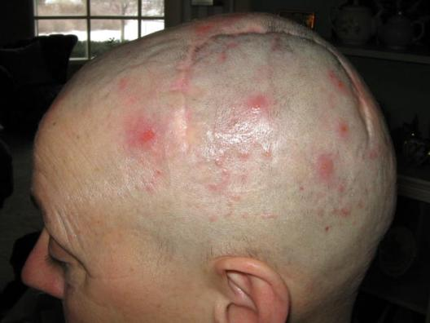
EF-11: NovoTTF-100A Treatment-Related Adverse Events (All Grades)
 | NovoTTF-100A treatment* (n = 116) n (%)
Medical device site reaction | 18 (16)
Headache | 4 (3)
Malaise | 2 (2)
Muscle twitching | 1 (1)
Fall | 1 (1)
Skin ulcer | 1 (1)
Grade 2 skin irritation underneath transducer arrays¹
*NovoTTF-100A System instructions for use
1. Stupp R, et al. Eur J Cancer. 2012;48(14):2192-2202.
Notes:
EF-11 Treatment related AEs – all Grades
This slide shows an example of a grade 2 skin reaction (Dermatology advises giving a higher concentration of steroids which provides good results)
use of antibiotics recommended when the skin actually breaks down
important to educate the care givers to rotate the sites of arrays
Procedural complications is a bucket term for device related a/e’s – which were almost all skin irritation beneath the arrays. (FDA/PMA document)
FYI: Premarket Approval (PMA) is a the most rigorous process for medical device approval.
Under the PMA process, new medical devices require a phase III clinical trial and review by an Expert advisory panel -approval can take many years. Lower risk devices which are not a novel concept and have predicate devices (e.g. a new catheter design) only necessitate preclinical data and engineering for approval. The PMA process is identical to the NDA process for a new drug.
20
Stupp 2012: p2194/Fig1B

Slide 21
EF-11: Quality of Life Assessment
Improved cognitive and emotional functions in patients treated with NovoTTF-100A system compared to patients treated with chemotherapy
Cognitive functioning
Emotional functioning
Global health
Role functioning
Social functioning
Physical functioning
Deterioration
Change from baseline
in functioning score at 3 months
Improvement
Stupp R, et al. Eur J Cancer. 2012;48(14):2192-2202.
Notes:
EF-11 QoL
Biggest obstacle is the loss of hair for most patients
Most patients have reported an improvement in their cognition
Social function was initially negative but this has begun to change as patients network and find ways to deal with the device
More contact between families has also made a difference

Slide 22
Conclusions of EF-11 trial
The NovoTTF-100A system shows comparable efficacy with cytotoxic chemotherapies
Patients treated with NovoTTF-100A experienced lower toxicity and a better quality of life than those treated with chemotherapies
Notes:
Conclusion
FDA approval for the device was based on the EF-11 trial results
TTF show comparable efficacy as systemic therapy
Patients experience fewer side effect and better QoL versus systemic therapy

Slide 23
The PRiDe Dataset: An Analysis of Patient Registry Data N = 457
All recurrent glioblastoma patients in US treated with Novo TTF (October 2011─November 2013)
OS in PRiDE compared to OS of patients receiving NovoTTF therapy in EF-11 trial (ITT group)
Patient characteristics prognostic for survival with NovoTTF Therapy were assessed
Subgroup analyses performed on patient characteristics were correlated with OS
Wong ET, et al. Proceedings of the American Society Of Clinical Oncology Annual Meeting. 2014: Abstract #e13033.
Stupp R, et al. Eur J Cancer. 2012;48(14):2192-2202.
Notes:
The PRiDe dataset, a registry of 457 recurrent glioblastoma patients, shows that patients treated in real-life setting and not selected like those in clinical trials.
PRiDe dataset represents about 5% of the treatable recurrent GBM population in the US (n = 457 patients)

Slide 24
Baseline Demographics
 |  | PRiDe dataset | EF-11 NovoTTF¹ therapy | EF-11 active chemotherapy¹
 | N | 457 | 120 | 117
Age (years) | Median (range) | 55 (18-86) | 54 (24-80) | 54 (29-74)
Gender | Male | 67.6% | 77% | 62%
 | Female | 32.4% | 23% | 38%
KPS | Median (range) | 80 (10-100) | 80 (50-100) | 80 (50-100)
Recurrence | Median (range) | 2 (1-5) | 2 (1-5) | 2 (1-4)
 | 1st | 33.3% | 9% | 15%
 | 2nd | 26.9% | 48% | 46%
 | 3rd-5th | 27.4% | 43% | 39%
 | Unknown | 12.5% | 0% | 0%
Prior treatments | Bevacizumab | >55.1% | 19% | 18%
 | Radiotherapy + temozolomide | >77.9% | 86% | 82%
 | Debulking surgery | >63.9% | 79% | 85%
 | Carmustine wafers | >3.7% | NA | NA
1. Stupp R, et al. Eur J Cancer. 2012;48(14):2192-2202.
Notes:
Patients in the PRiDe dataset = recurrent GBM population. Key patient characteristics included the following:
Median patient age was 55 (range 18-86)
About one third of the patients were female
Median KPS 80% (range 10-100)
Approximately 1/3 of the patients were 1st recurrence
At least 55% of the patients had received a prior bevacizumab-based regimen

Slide 25
Safety Analysis (> 2%)
Adverse event | Percentage of patients (n = 457)
Skin reaction | 24.3
Heat sensation | 11.3
Neurological disorder | 10.4
Seizure | 8.9
Electric sensation | 7.7
Headache | 5.7
Pain / discomfort | 4.7
Fall | 3.9
Psychiatric disorder | 2.9
Gastrointestinal disorder | 2.9
Fatigue | 2.5
Notes:
Safety profile remains benign with skin irritation the only common device related adverse event.
No new safety signals have been detected.

Slide 26
PRiDe Overall Survival
 | PRiDe dataset | EF-11 NovoTTF therapy¹ | EF-11 active chemotherapy¹
Median treatment duration | 4.1 months (95% CI, 3.5-4.8) | 2.2 months (95% CI, 2.1-2.4) | 2.1 months (95% CI, 2.0-2.9)
Median compliance | 70% (range, 12-99) | 86% (range, 41-98) | NA
Median OS | 9.6 months (95% CI, 8.0-13.7) | 6.6 months | 6.0 months
HR of PRiDe vs others / P value | — | HR = 0.66 (95% CI) P = .0003 | HR = 0.58 (95% CI) P = .0001
1-/2 -year survival | 44% / 30% | 20% / 9% | 20% / 7%
1. Stupp R et al. Eur J Cancer. 2012;48(14):2192-2202.

Slide 27
PRiDe OS: Prognostic Factors
 | Median OS (months) | HR | P value
Daily compliance
≥75% | 13.5 | 0.4 (95% Cl, 0.3-0.6) | <.0001
<75% | 4
Bevacizumab use
Naïve | 13.4 | 0.5 (95% Cl, 0.4-0.7) | .0001
Prior use | 7.2
Debulking surgery
No | 8.9 | 1.1 (95% CI, 0.8-1.5) | .7927
Yes (any) | 9.8

Slide 28
PRiDe OS: Prognostic Factors (2)
 | Median OS (months) | HR | P value
KPS
90-100 | 14.8 | — | —
70-80 | 7.7 | 0.6 (95% CI, 0.4-0.9) | .0070ª
10-60 | 6.1 | 0.4 (95% CI, 0.2-0.6) | <.0001^{b}
Number of recurrences
1st | 20 | — | —
2nd | 8.5 | 0.6 (95% CI, 0.4-0.9) | .0271^{c}
3rd-5th | 4.9 | 0.3 (95% CI, 0.2-0.5) | <.0001^{d}
ª KPS 90-100 compared to KPS 70-80. ^{b} KPS 90-100 compared to KPS 10-60.
^{c} First recurrence compared to 2nd recurrence. ^{d} First recurrence compared to 3rd through 5th recurrence.

Slide 29
Conclusions of TTF Trials
Combined total of nearly 700 patients: EF-11 (N = 237) + PRiDe (N = 457), represents the most robust dataset published in recurrent glioblastoma
Safety profile benign
OS with PRiDe similar to EF-11 phase III study¹
Median OS of 9.6 versus 6.6 months
1-year survival 44% versus 20%
2-year survival 30% versus 9%
PRiDe confirms prognostic factors that predict survival:
Compliance ≥18 hours/day
Bevacizumab-naïve patients
Performance status
Use in first recurrence
Stupp R, et al. Eur J Cancer 2012;48(14):2192-2202.
Notes:
NovoTTF Therapy is a standard of care for patients with recurrent GBM and should be offered to all eligible patients

